Slide 1
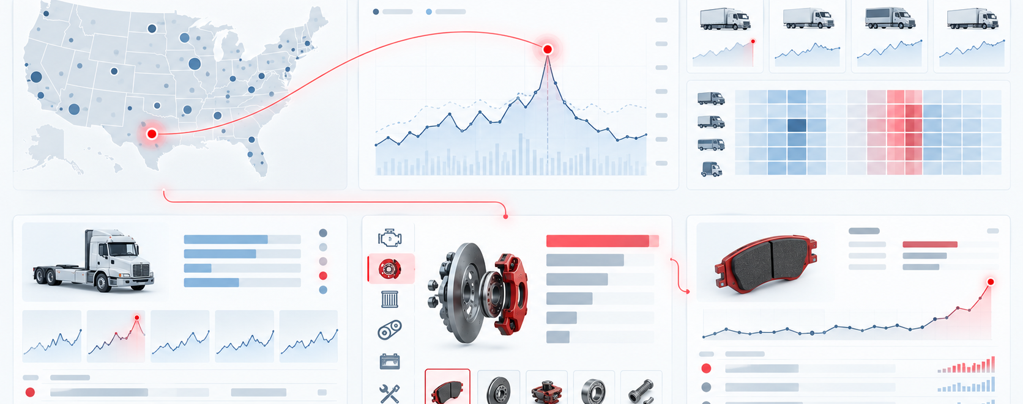
Data story: where should UMI act first?
Prototype of an analytical narrative: overview → explain → drill down → decide.
ISZE / UMI Sales Review Prototype
source: UMI Sales Review FY2027
Notes:
[Sources]
- Source deck: ISZE_UMI_Sales_Review_FY2027_ModeA_only.pptx. UMI review title and meeting context: lines 23-25.
- FY2027 YTD and budget/LY figures: lines 55-65.
- Commercial parts performance: lines 70-80.
- Category movers: lines 85-150.
- GPS, service-parts coverage, IDS and fleet/target data: lines 176-235 and 240-276.
- SPA and Sales-to-Dealer ask: lines 286-345.

Slide 2
Overview: UMI is above budget but below last year
Use an analytical dashboard to show the contradiction immediately.
Commercial parts
+33.6%
CY H1 2026 vs CY H1 2025
July warning
-38% YoY
Shell lubricants on hold
GPS capture
54.2%
fleet potential €4.636m
ISZE / UMI Sales Review Prototype
source: UMI Sales Review FY2027
Notes:
[Sources]
- Source deck: ISZE_UMI_Sales_Review_FY2027_ModeA_only.pptx. UMI review title and meeting context: lines 23-25.
- FY2027 YTD and budget/LY figures: lines 55-65.
- Commercial parts performance: lines 70-80.
- Category movers: lines 85-150.
- GPS, service-parts coverage, IDS and fleet/target data: lines 176-235 and 240-276.
- SPA and Sales-to-Dealer ask: lines 286-345.

Slide 3
Explain: category movements point to two different stories
Growth exists, but service categories remain under-captured.
ISZE / UMI Sales Review Prototype
source: UMI Sales Review FY2027
Notes:
[Sources]
- Source deck: ISZE_UMI_Sales_Review_FY2027_ModeA_only.pptx. UMI review title and meeting context: lines 23-25.
- FY2027 YTD and budget/LY figures: lines 55-65.
- Commercial parts performance: lines 70-80.
- Category movers: lines 85-150.
- GPS, service-parts coverage, IDS and fleet/target data: lines 176-235 and 240-276.
- SPA and Sales-to-Dealer ask: lines 286-345.

Slide 4
Decide: the dashboard should end with actions, not more filters
Turn the Tableau-style story into four customer commitments.
Decision panel
Close Shell price hold
Pick first service-parts pilot
Return SPA counter-list
Share Sales-to-Dealer data
ISZE / UMI Sales Review Prototype
source: UMI Sales Review FY2027
Notes:
[Sources]
- Source deck: ISZE_UMI_Sales_Review_FY2027_ModeA_only.pptx. UMI review title and meeting context: lines 23-25.
- FY2027 YTD and budget/LY figures: lines 55-65.
- Commercial parts performance: lines 70-80.
- Category movers: lines 85-150.
- GPS, service-parts coverage, IDS and fleet/target data: lines 176-235 and 240-276.
- SPA and Sales-to-Dealer ask: lines 286-345.

